Slide 1
Unawareness
- Minicourse -
Burkhard C. Schipper
University of California, Davis
TexPoint fonts used in EMF.
Read the TexPoint manual before you delete this box.: AAAAAAAAAAAAAAAAAAA

Slide 2
Outline
Informal introduction
Epistemic models of unawareness
Type spaces with unawareness
Speculation
Bayesian games with unawareness
Revealed unawareness
Dynamic games with unawareness
…(???)

Slide 3
1. An informal introduction

Slide 4
“Awareness” in Natural Language
“I was aware of the red traffic light.” (Just knowledge?)
“Be of aware of sexually transmitted diseases!"
(“generally taking into account", “being present in mind", “paying attention to“)
Etymology: “aware” ← “wary” ← “gewӕr” (old English) ← “gewahr” (German)
Psychiatry: Lack of self-awareness means that a patient is oblivious to aspects of an illness that is obvious to his/her social contacts. (Failure of negative introspection.)

Slide 5
“Reports that say that something hasn't happened are always interesting to me, because as we know, there are known knowns; there are things we know we know. We also know there are known unknowns; that is to say we know there are some things we do not know. But there are also unknown unknowns – the ones we don't know we don't know. And if one looks throughout the history of our country and other free countries, it is the latter category that tend to be the difficult ones.”
(Former) United States Secretary of Defense, Donald Rumsfeld, February 12, 2002

Slide 6
Unawareness as Lack of Conception
In most formal approaches:
Unawareness means the lack of conception.
(“not being present in the mind”)
Lack of information versus lack of conception:

Slide 7
We all know the homo oeconomicus.
But how did he look as a baby?

Slide 11
!₁ !₂ !₃
!₄ !₅ !₆ !₇ !₈ !₉ !₁₀ !₁₁
!₁₂ !₁₃ !₁₄ !₁₅ !₁₆ !₁₇ !₁₈ !₁₉
!₂₀ !₂₁ !₂₂ !₂₃ !₂₄ !₂₅ !₂₆ …

Slide 12
!₁ !₂ !₃
!₄ !₅ !₆ !₇ !₈ !₉ !₁₀ !₁₁
!₁₂ !₁₃ !₁₄ !₁₅ !₁₆ !₁₇ !₁₈ !₁₉
!₂₀ !₂₁ !₂₂ !₂₃ !₂₄ !₂₅ !₂₆ …

Slide 13
!₁ !₂ !₃
!₄ !₅ !₆ !₇ !₈ !₉ !₁₀ !₁₁
!₁₂ !₁₃ !₁₄ !₁₅ !₁₆ !₁₇ !₁₈ !₁₉
!₂₀ !₂₁ !₂₂ !₂₃ !₂₄ !₂₅ !₂₆ …
!
!
!
!
!
!
!
!

Slide 14
Standard models allow for the lack of information but not for the lack of conception.
In standard models, learning means shrinking the relevant state space but never discovering of new possibilities.

Slide 15
An agent may have lack of conception of an event because:
never thought about it (i.e., novelties)
does not pay attention to it at the very moment we model (different from rational inattention)

Slide 16
Relevance of unawareness
It is real phenomena
Incomplete contracting, incomplete markets
Speculation in financial markets
Disclosure of information
Strategic negotiations and bargaining
Modelling discoveries and innovations
Modeling games where the perception of the strategic context is not necessarily “common” among players
Exploring robustness of decision theory to small changes in assumptions on the primitives
…

Slide 17
Non-robustness of Decision Theory
In decision theory, the decision maker’s perception of the problem are captured in the primitives (state space, set of consequences, acts etc.)
These primitives are assumed by the modeler and are not revealed.
Preference are revealed given primitives.
How do we know that the decision maker views the problem the same as the modeler?

Slide 18
Example: Non-robustness of the Ellsberg Paradox

Slide 19
Example: Non-robustness of the Ellsberg Paradox

Slide 20
Example: Non-robustness of the Ellsberg Paradox
Rationalizes Ellsberg behavior with expected utility
on a slightly different state-space.
Unawareness models allow us to analyze decisions under varying primitives.

Slide 21
How to model unawareness?

Slide 22
2. Epistemic models of unawareness

Slide 23
What’s the problem with modeling unawareness?
Why not take a state-space model a la Aumann or a Kripke frame?

Slide 24



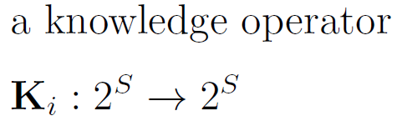
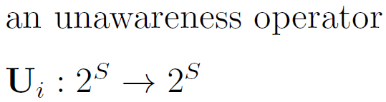
What’s the problem with modeling unawareness?

Slide 25
Digression: Necessitation of Belief

Slide 26
Digression: Necessitation of Belief

Slide 27
Digression: Necessitation of Belief

Slide 28

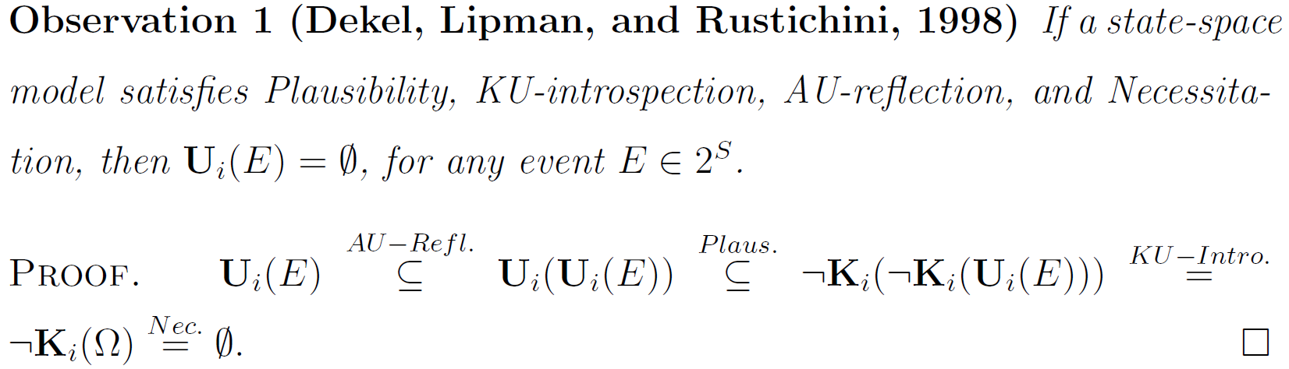
What’s the problem with modeling unawareness?

Slide 29
Modeling Unawareness

Slide 30
Various approaches, interdisciplinary
Computer science
Modeling logical non-omniscience and limited reasoning
Inspired by Kripke structures
Analyst’s description of agents’ reasoning
Seminal work: Fagin and Halpern (AI 1988)
Economics
Focused on modeling lack of conception while keeping everything else standard
Inspired by Aumann structures and Harsanyi type spaces
Players’ descriptions of players’ reasoning

Slide 31
Unawareness Structures
Goals:
Define a structure consistent with non-trivial unawareness in the multi-agent case.
Prove all properties of awareness of Dekel, Lipman, Rustichini (1998), Modica and Rustichini (1999), Halpern (2001)
Prove unawareness is consistent with strong notions of knowledge (like S4 or stronger).
Clear separation between syntax and semantics to facilitate applications.

Slide 33
Digression: Lattices

Slide 34
Digression: Lattices

Slide 35
Digression: Lattices

Slide 37
pqr
●
pq¬r
●
¬pqr
●
¬pq¬r
●
p¬qr
●
p¬q¬r
●
¬p¬qr
●
¬p¬q¬r
●

Slide 38
pqr
●
pq¬r
●
¬pqr
●
¬pq¬r
●
p¬qr
●
p¬q¬r
●
¬p¬qr
●
¬p¬q¬r
●
pq
●
¬pq
●
p¬q
●
¬p¬q
●

Slide 39
pqr
●
pq¬r
●
¬pqr
●
¬pq¬r
●
p¬qr
●
p¬q¬r
●
¬p¬qr
●
¬p¬q¬r
●
pq
●
¬pq
●
pr
●
¬pr
●
qr
●
¬qr
●
p¬q
●
¬p¬q
●
p¬r
●
¬p¬r
●
q¬r
●
¬q¬r
●

Slide 40
pqr
●
pq¬r
●
¬pqr
●
¬pq¬r
●
p¬qr
●
p¬q¬r
●
¬p¬qr
●
¬p¬q¬r
●
pq
●
¬pq
●
pr
●
¬pr
●
qr
●
¬qr
●
p¬q
●
¬p¬q
●
p¬r
●
¬p¬r
●
q¬r
●
¬q¬r
●
●
p
●
¬p
●
q
●
¬q
●
r
●
¬r

Slide 41
pqr
●
pq¬r
●
¬pqr
●
¬pq¬r
●
p¬qr
●
p¬q¬r
●
¬p¬qr
●
¬p¬q¬r
●
pq
●
¬pq
●
pr
●
¬pr
●
qr
●
¬qr
●
p¬q
●
¬p¬q
●
p¬r
●
¬p¬r
●
q¬r
●
¬q¬r
●
●
p
●
¬p
●
q
●
¬q
●
r
●
¬r
●
Ø

Slide 44
Digression: Surjection
Student 1
Thomas
Student 2
Student 3
Anna
Student 4
京

Slide 46
pqr
●
pq¬r
●
¬pqr
●
¬pq¬r
●
p¬qr
●
p¬q¬r
●
¬p¬qr
●
¬p¬q¬r
●
pq
●
¬pq
●
pr
●
¬pr
●
qr
●
¬qr
●
p¬q
●
¬p¬q
●
p¬r
●
¬p¬r
●
q¬r
●
¬q¬r
●
●
p
●
¬p
●
q
●
¬q
●
r
●
¬r
●
Ø

Slide 47
pqr
●
pq¬r
●
¬pqr
●
¬pq¬r
●
p¬qr
●
p¬q¬r
●
¬p¬qr
●
¬p¬q¬r
●
pq
●
¬pq
●
pr
●
¬pr
●
qr
●
¬qr
●
p¬q
●
¬p¬q
●
p¬r
●
¬p¬r
●
q¬r
●
¬q¬r
●
●
p
●
¬p
●
q
●
¬q
●
r
●
¬r
●
Ø

Slide 50
pqr
●
pq¬r
●
¬pqr
●
¬pq¬r
●
p¬qr
●
p¬q¬r
●
¬p¬qr
●
¬p¬q¬r
●
pq
●
¬pq
●
pr
●
¬pr
●
qr
●
¬qr
●
p¬q
●
¬p¬q
●
p¬r
●
¬p¬r
●
q¬r
●
¬q¬r
●
●
p
●
¬p
●
q
●
¬q
●
r
●
¬r
●
Ø

Slide 52
pqr
●
pq¬r
●
¬pqr
●
¬pq¬r
●
p¬qr
●
p¬q¬r
●
¬p¬qr
●
¬p¬q¬r
●
pq
●
¬pq
●
pr
●
¬pr
●
qr
●
¬qr
●
p¬q
●
¬p¬q
●
p¬r
●
¬p¬r
●
q¬r
●
¬q¬r
●
●
p
●
¬p
●
q
●
¬q
●
r
●
¬r
●
Ø

Slide 54
pqr
●
pq¬r
●
¬pqr
●
¬pq¬r
●
p¬qr
●
p¬q¬r
●
¬p¬qr
●
¬p¬q¬r
●
pq
●
¬pq
●
pr
●
¬pr
●
qr
●
¬qr
●
p¬q
●
¬p¬q
●
p¬r
●
¬p¬r
●
q¬r
●
¬q¬r
●
●
p
●
¬p
●
q
●
¬q
●
r
●
¬r
●
Ø

Slide 57
pqr
●
pq¬r
●
¬pqr
●
¬pq¬r
●
p¬qr
●
p¬q¬r
●
¬p¬qr
●
¬p¬q¬r
●
pq
●
¬pq
●
pr
●
¬pr
●
qr
●
¬qr
●
p¬q
●
¬p¬q
●
p¬r
●
¬p¬r
●
q¬r
●
¬q¬r
●
●
p
●
¬p
●
q
●
¬q
●
r
●
¬r
●
Ø

Slide 59
pqr
●
pq¬r
●
¬pqr
●
¬pq¬r
●
p¬qr
●
p¬q¬r
●
¬p¬qr
●
¬p¬q¬r
●
pq
●
¬pq
●
pr
●
¬pr
●
qr
●
¬qr
●
p¬q
●
¬p¬q
●
p¬r
●
¬p¬r
●
q¬r
●
¬q¬r
●
●
p
●
¬p
●
q
●
¬q
●
r
●
¬r
●
Ø

Slide 61
pqr
●
pq¬r
●
¬pqr
●
¬pq¬r
●
p¬qr
●
p¬q¬r
●
¬p¬qr
●
¬p¬q¬r
●
pq
●
¬pq
●
pr
●
¬pr
●
qr
●
¬qr
●
p¬q
●
¬p¬q
●
p¬r
●
¬p¬r
●
q¬r
●
¬q¬r
●
●
p
●
¬p
●
q
●
¬q
●
r
●
¬r
●
Ø

Slide 64
• !
S
¦_{i}(!)
S’

Slide 65
• !
¦_{i}(!)
•!’
¦_{i}(!‘)
• !’’
S
S
S“
¦_{i}(!)
¦_{i}(!‘‘)
• !
S’
S’
S’’’

Slide 67
• !
S
¦_{i}(!)
S’

Slide 68
• !
• ω
S
S
¦_{i}(!)
¦_{i}(!)
S’
S’

Slide 70
¦_{i}(!) = ¦_{i}(!‘)
• ! • !’
S

Slide 71
¦_{i}(!)
¦_{i}(!‘)
¦_{i}(!) = ¦_{i}(!‘)
• ! • !’
• ! • !’
• !’’
S
S
¦_{i}(!‘‘)
S’

Slide 73
• ! ¦_{i}(!)
S’
• !_{S} ¦_{i}(!_{S})
S

Slide 74
• ! ¦_{i}(!)
• ! ¦_{i}(!)
S’
S’
• !_{S}
S
• !_{S} ¦_{i}(!_{S})
¦_{i}(!_{S})
S
S‘‘

Slide 76
• !
S’
¦_{i}(!)
• !_{S}
S
¦_{i}(!_{S})

Slide 77
• !
• !
S’
S’
¦_{i}(!)
¦_{i}(!)
• !_{S}
• !_{S}
S
S
¦_{i}(!_{S})
¦_{i}(!_{S})

Slide 79
• !
S“
¦_{i}(!)
S’
• !_{S}
¦_{i}(!_{S}) = (¦_{i}(!))_{S}
S

Slide 80
• !
• !
S“
S“
¦_{i}(!)
¦_{i}(!)
S’
S’
• !_{S}
• !_{S}
¦_{i}(!_{S}) = (¦_{i}(!))_{S}
¦_{i}(!_{S}) ¾ (¦_{i}(!))_{S}
S
S

Slide 90
Illustration
E = {!₂}
!₂
!₃
A_{b}(E)={!₂}
U_{b}(E) = {!₃}
:K_{a}U_{b}(E) = {!₂, !₃}
:K_{a}A_{b}(E) = {!₂, !₃}
K_{b}:K_{a}U_{b}(E) = {!₂}
A_{a}K_{b}:K_{a}U_{b}(E) = {!₂, !₃}
…
!₁

Slide 95
Logic of unawareness
Syntax versus semantics: What’s the internal structure of states? What’s the interpretation of the lattice?
How comprehensive are unawareness structures? Can the model itself be subject to agents’ uncertainties? Can any minute detail of awareness, beliefs, mutual beliefs, etc. of all individuals be described in some state of the model?
Soundness: Is any theorem valid in all states?
Completeness: Is every formula that is valid in all states also provable?

Slide 116
An Example: Speculative Trade
How to model the following example?
Two agents: An owner o of a firm and a potential buyer b.
Status quo value of the firm is $100.
The owner is aware of a potential lawsuit l that may cost the firm $20. The buyer is unaware of it. The owner knows that the buyer is unaware of it.
The buyer is aware of a potential innovation n that may enhance the value of the firm by $20. The owner is unaware of it. The buyer knows that the owner is unaware of it.
Suppose the buyer is offering to buy the firm for $100. Is the owner going to sell to her?

Slide 117
An Example: Speculative Trade
● ● ● ●
n, l
n, :l
:n, l
:n,:l
S_{n, l}
● ●
● ●
n
:n
l
:l
S_{n}
S_{l}
●
>
S;

Slide 118
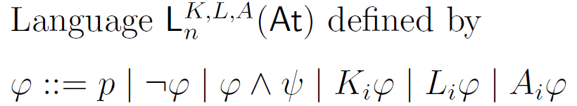
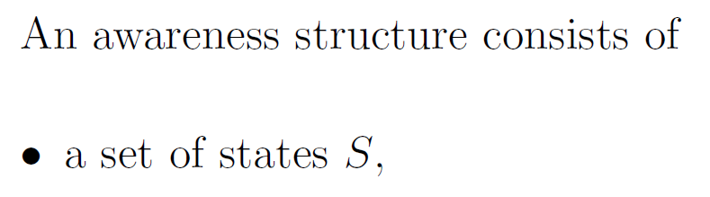

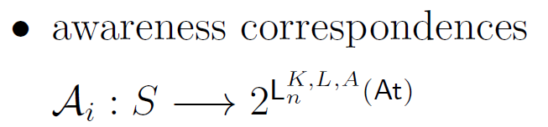
The First Approach: Awareness Structures
(Fagin and Halpern, Artificial Intelligence 1988)
L(n)
L(l)
L(n)
L(l)
● ●
● ●
n, l
n, :l
L(n)
L(l)
L(n)
L(l)
:n, l
:n,:l

Slide 119
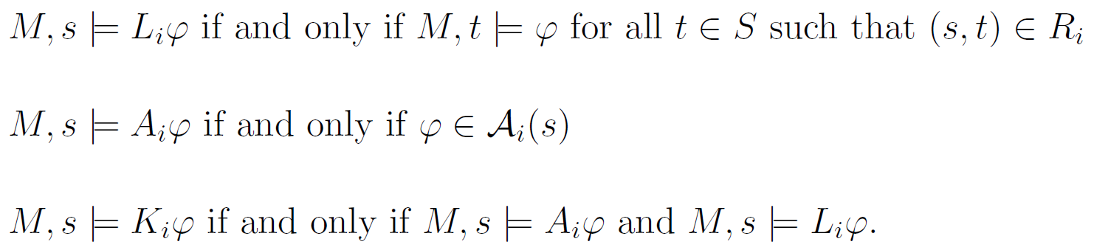
Fagin and Halpern (1988), Halpern (2001), Halpern and Rego (2008) provide sound and complete axiomatizations of awareness structures under various assumptions on accessibility relations and awareness correspondences. (details)
The example models our story.
L(n)
L(l)
L(n)
L(l)
● ●
● ●
n, l
n, :l
L(n)
L(l)
L(n)
L(l)
:n, l
:n,:l

Slide 120

Buyer: “I (implicitly) know that the owner is aware of the lawsuit but unfortunately I am unaware of the lawsuit.”
It models reasoning of an outside observer about the knowledge and awareness of agents but not the agents’ subjective reasoning that economists, decision theorists, and game theorists are interested in.
Semantics is not syntax-free. What would be the analogue to a Kripke frame?
L(n)
L(l)
L(n)
L(l)
● ●
● ●
n, l
n, :l
L(n)
L(l)
L(n)
L(l)
:n, l
:n,:l
Awareness structures are very flexible. For instance,
Should be very useful to model various forms of framing.

Slide 121
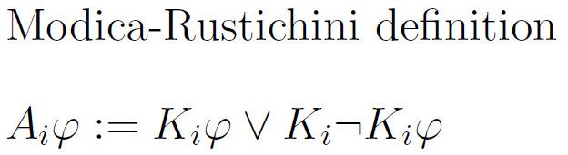
The Second Approach: Generalized Standard Models
(Modica and Rustichini, GEB 1999)
● ● ● ●
Single-agent structure
n, l
n, :l
:n, l
:n,:l
S_{n, l}
● ●
n
:n
Modica and Rustichini (1999) prove a sound and complete axiomatization.
Use “objective” validity.
Models reasoning of an outside observer about knowledge and awareness of a single agent.
S_{n}

Slide 122


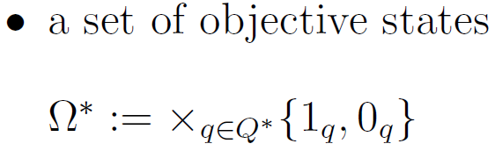
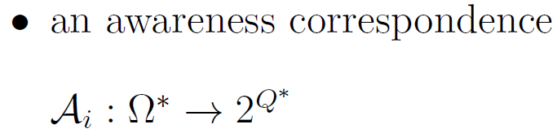
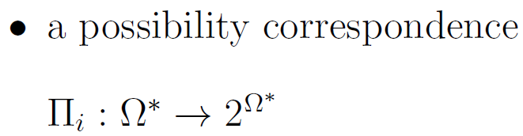
A Fourth Approach: Product Models
(Li, 2008, JET 2009)
n
l
n
l
● ●
● ●
(1_{n},1_{l})
(1_{n},0_{l})
n
l
n
l
(0_{n},1_{l})
(0_{n},0_{l})
Ω∗

Slide 123
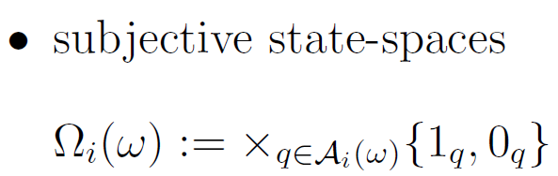
A Fourth Approach: Product Models
(Li, 2008, JET 2009)
n
l
n
l
n
l
n
l
● ● ● ●
(1_{n},1_{l})
(1_{n},0_{l})
(0_{n},1_{l})
(0_{n},0_{l})
Ω∗
● ●
● ●
(1_{n})
(0_{n})
(1_{n})
(0_{n})
Ω_{b}(Ω∗)
Ω_{o}(Ω∗)
●
Ω_{o} (Ω_{b}(Ω∗)) = Ω_{b} (Ω_{o}(Ω∗))

Slide 124
A Fourth Approach: Product Models
(Li, 2008, JET 2009)
n
l
n
l
n
l
n
l
● ● ● ●
(1_{n},1_{l})
(1_{n},0_{l})
(0_{n},1_{l})
(0_{n},0_{l})
Ω∗
n
;
n
;
;
l
;
l
● ●
● ●
(1_{n})
(0_{n})
(1_{n})
(0_{n})
Ω_{b}(Ω∗)
Ω_{o}(Ω∗)
;
;
●
Ω_{o} (Ω_{b}(Ω∗)) = Ω_{b} (Ω_{o}(Ω∗))

Slide 125
A Fourth Approach: Product Models
(Li, 2008, JET 2009)
Example models our story
Possibility correspondence
models implicit knowledge.
Sublattices represent
subjective perceptions of
the situation, while the
objective state space
represents the outside
modeler’s view.
Li (2009) proves properties of unawareness and knowledge
n
l
n
l
n
l
n
l
● ● ● ●
(1_{n},1_{l})
(1_{n},0_{l})
(0_{n},1_{l})
(0_{n},0_{l})
Ω∗
n
;
n
;
;
l
;
l
● ●
● ●
(1_{n})
(0_{n})
(1_{n})
(0_{n})
Ω_{b}(Ω∗)
Ω_{o}(Ω∗)
;
;
●
Ω_{o} (Ω_{b}(Ω∗)) = Ω_{b} (Ω_{o}(Ω∗))

Slide 126
Further Epistemic Approaches
Awareness of Unawareness:
Awareness structures with propositional quantifiers: Halpern and Rego (MSS 2013), Halpern and Rego (GEB 2009)
First-order modal logic with unawareness of objects: Board and Chung (2011)
First-order modal logic with unawareness of objects and properties: Quantified awareness neighborhood structures: Sillari (RSL 2008)
Awareness of unawareness without quantifiers: Agotnes and Alechina (2007), Walker (MSS 2014)
Dynamic awareness:
…

Slide 127
“Evolution” of the literature on epistemic models of unawareness
Survey:
Schipper, B.C. “Awareness”, in: Handbook of Epistemic Logic,
Chapter 3, H. van Ditmarsch, J.Y. Halpern, W. van der Hoek
and B. Kooi (Eds.), College Publications, London, 2015,
77–146.

Slide 128
Li (2009)
Prod. models
Heinsalu (2012)
Halpern (2001)
Single-agent aw. struc.
Halpern (2001)
Modica Rustichini (1999)
Gen. stand. models
Pires
(1994)
Single-agent
Multi-agent
Li (2008) Multi-
agent prod. m.
HMS (2006, 2008)
Unawareness struct.
Board Chung Schipper (2011)
Halpern Rego (2008)
Ewerhart
(2001)
Board Chung (2011b)
Obj.-based unaw.
FH (1988) Prop. gen.
awareness structures
Feinberg (2004,
2005, 2012)
van Ditmarsch et al.
(2013)
Wansing (1990)
Galanis
(2011, 2013)
Fagin Halpern (1988)
Awarness struct.
Rantala (1982)
Impossible worlds
Agotnes Alechina
(2007)
Sillari (2008b)
Walker
(2013)
Sillari (2008a)
Aw. neighb.
Sillari (2008a) Imp.
worlds neighb.
Quantification
Halpern Rego (2009)
Prop. quant. aw. struct.
Halpern Rego (2013)
Prop. quant. aw. struct.
Board Chung (2011a)
FO Obj.-based unaw.
Sillari (2008b)
Sillari (2008a)
FO Aw. neighb.
Sillari (2008a) FO
Imposs. w. neighb.

Slide 130
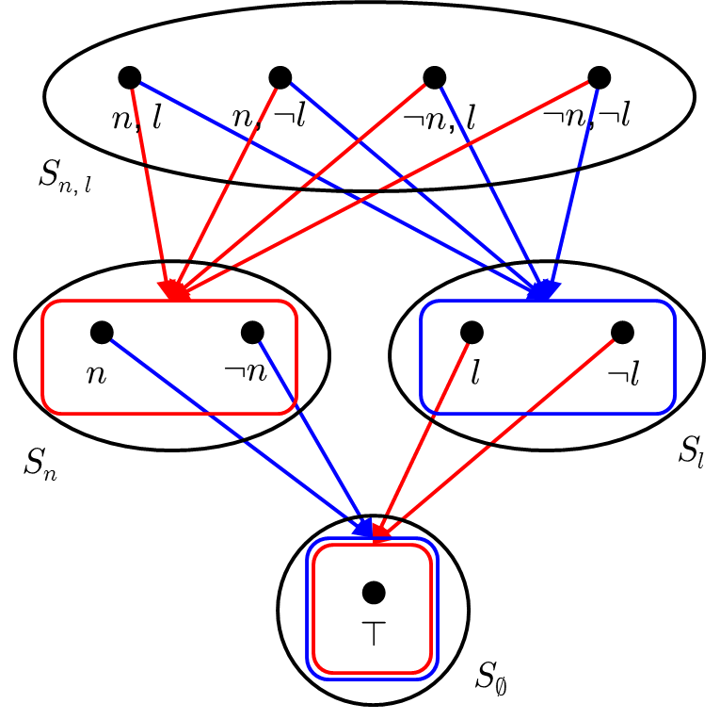
Returning to the speculative trade example:
Say that at a state s an agent is willing to trade at the price $x if either she strictly prefers to trade at $x or she is indifferent between trading or not at $x.
At $100, both agents are willing to trade (in every state).
This is common knowledge among the agents at all states.
Yet, each agent has a strict preference to trade in all in all states except the lowest space. Both are indifferent between trading and not trading in the lowest space. The states in the lowest space are the “states of mind” of an agent as viewed by the other agent.

Slide 131
Returning to the speculative trade example:
Say that at a state s an agent is willing to trade at the price $x if either she strictly prefers to trade at $x or she is indifferent between trading or not at $x.
At $100, both agents are willing to trade (in every state).
This is common knowledge among the agents at all states.
Yet, each agent has a strict preference to trade in all in all states except the lowest space. Both are indifferent between trading and not trading in the lowest space. The states in the lowest space are the “states of mind” of an agent as viewed by the other agent.
This is in contrast to the “No-speculative-trade-theorems” of structures without unawareness (e.g., Milgrom and Stokey, 1982):
If there is a common prior and common knowledge of willingness to trade, then both must be indifferent to trade.
Need to talk about probabilities.

Slide 132
Outline
Informal introduction
Epistemic models of unawareness
Type spaces with unawareness
Speculation
Bayesian games with unawareness
Revealed unawareness
Dynamic games with unawareness
…(???)

Slide 133
3. Type spaces with unawareness

Slide 134
Type Spaces with Unawareness
Economists frequently make use of probabilistic notions of belief
Quantified notions of belief are often useful for applications (optimization under uncertainty)
How to model unawareness and probabilistic beliefs?

Slide 138
• ω
S’
t_{i}(ω)
S

Slide 139
• ω
t_{i}(ω)
t_{i}(ω’)
• ω’
S’
S’
S“
t_{i}(ω)
• ω
S
S

Slide 141
• ω
S’’
• ω_{S’}
S’
t_{i}(ω) = t_{i}(ω_{S’})
S

Slide 142
• ω
• ω
S’’
S“
• ω_{S’}
• ω_{S’}
S’
S’
t_{i}(ω) = t_{i}(ω_{S’})
t_{i}(ω)
t_{i}(ω_{S'})
S
S
t_{i}(ω_{S’})
S*

Slide 144
• ω
S’’
t_{i}(ω)
S’
t_{i}(ω_{S})
t_{i}(ω_{S}) = t_{i}(ω)_{|S}
S

Slide 145
• ω
• ω
S’’
S’’
t_{i}(ω)
t_{i}(ω)
S’
S’
t_{i}(ω_{S}) = t_{i}(ω)_{|S}
t_{i}(ω_{S})
t_{i}(ω)_{|S}
S
S

Slide 147
• ω
S’’
t_{i}(ω)
•ω_{S’}
S’
S
t_{i}(ω)
t_{i}(ω_{S’})
S

Slide 148
• ω
• ω
S’’
S’’
t_{i}(ω)
•ω_{S’}
S’
S
t_{i}(ω)
t_{i}(ω_{S’})
• ω_{S’}
S
S’
t_{i}(ω_{S’})
t_{i}(ω)
S
S
t_{i}(ω)
t_{i}(ω)

Slide 157
4. Speculation

Slide 158
Revisiting to the speculative trade example
Status quo value of the firm depends on high ($100) or low ($80) sales, which is equiprobable.
Both whether or not there is a lawsuit and whether or not there is a novelty are equiprobably too.
Moreover, all events are independent.

Slide 159
nls n¬ls nl¬s n¬l¬s ¬nls ¬n¬ls ¬nl¬s ¬n¬l¬s
● ● ● ● ● ● ● ●
S_{{nls}}
ns n¬s ¬ns ¬n¬s
● ● ● ●
ls l¬s ¬ls ¬l¬s
● ● ● ●
S_{{ns}}
S_{{ls}}
s ¬s
● ●
S_{{s}}

Slide 160
nls n¬ls nl¬s n¬l¬s ¬nls ¬n¬ls ¬nl¬s ¬n¬l¬s
● ● ● ● ● ● ● ●
S_{{nls}}
ns n¬s ¬ns ¬n¬s
● ● ● ●
¼ ¼ ¼ ¼
ls l¬s ¬ls ¬l¬s
● ● ● ●
¼ ¼ ¼ ¼
S_{{ns}}
S_{{ls}}
s ¬s
● ●
½ ½
S_{{s}}

Slide 161
nls n¬ls nl¬s n¬l¬s ¬nls ¬n¬ls ¬nl¬s ¬n¬l¬s
● ● ● ● ● ● ● ●
⅛ ⅛ ⅛ ⅛ ⅛ ⅛ ⅛ ⅛
S_{{nls}}
ns n¬s ¬ns ¬n¬s
● ● ● ●
¼ ¼ ¼ ¼
ls l¬s ¬ls ¬l¬s
● ● ● ●
¼ ¼ ¼ ¼
S_{{ns}}
S_{{ls}}
s ¬s
● ●
½ ½
S_{{s}}

Slide 162
Revisiting to the speculative trade example
There is a common prior (i.e., a projective system of probability measures with which agents’ types are consistent) and common certainty of willingness to trade but each agent has a strict preference to trade.
Counterexample to Milgrom and Stokey (1982).
Speculative trade is possible under unawareness.
Knife-edge case???

Slide 165
• ω₃ • ω₄
1/9 2/9
• ω₁ • ω₂
1/18 2/18
• ω₅ • ω₆
1/18 2/18
• ω₇ • ω₈
1/9 2/9
S’
• ω_{odd} • ω_{even}
1/3 2/3
S

Slide 168
5. Bayesian games with unawareness

Slide 169
Bayesian games with unawareness
Unawareness of (payoff-)relevant events, actions, and players.
Replace type space with unawareness type space.
Digression: How do we model uncertainty over action sets in standard games?

Slide 172
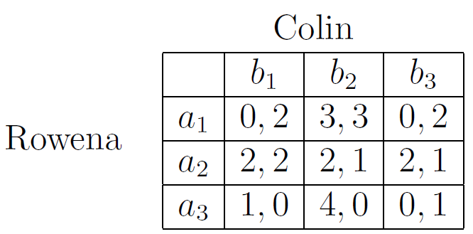
Example (Feinberg 2005)
Unique Nash equilibrium (a₂, b₁)

Slide 173
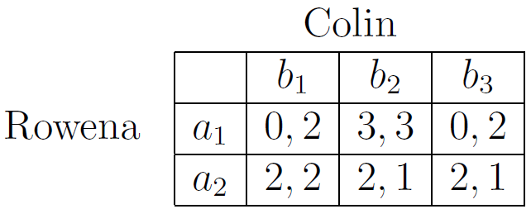
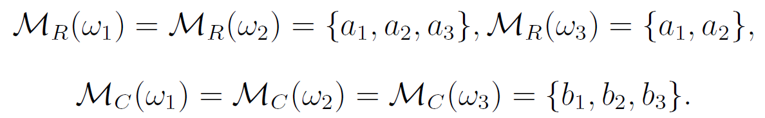
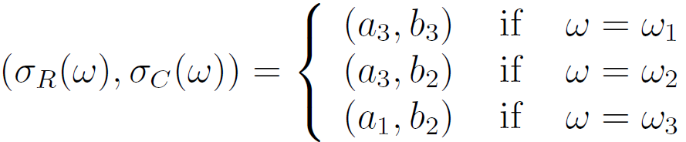
!₁ !₂
S
!₃
S’
An equilibrium

Slide 174
!₁ !₂
S
!₃
S’
An equilibrium

Slide 178
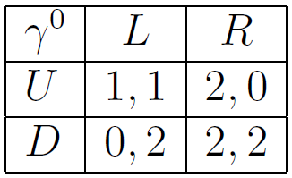
Unawareness perfection

Slide 179
Unawareness perfection

Slide 180
Unawareness perfection

Slide 181
Unawareness perfection

Slide 182
Unawareness perfection

Slide 183
Unawareness perfection

Slide 184
Unawareness perfection

Slide 185
Unawareness perfection

Slide 186
Unawareness perfection

Slide 187
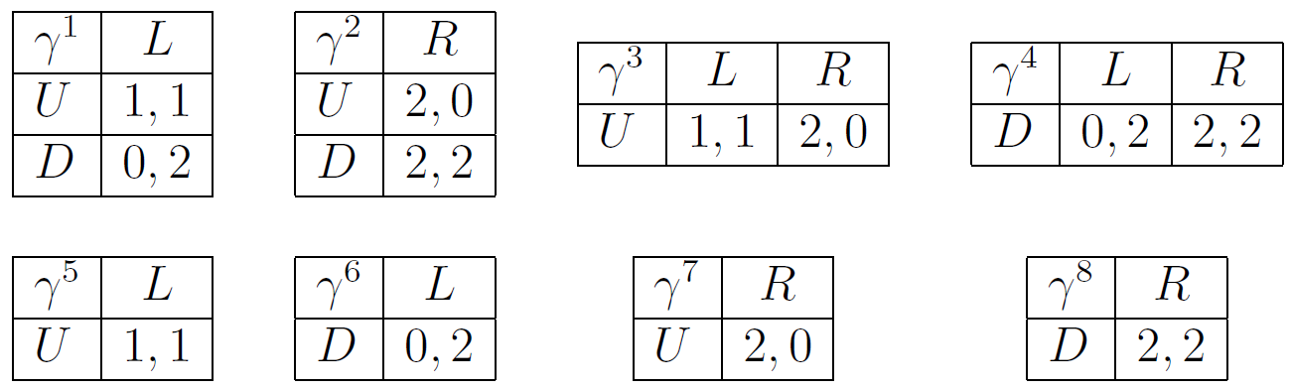
Opponents could have any awareness level
Full support belief over types of opponent
Consider limit belief over opponent’s types close to him being fully aware.
Limit Bayesian Nash equilibrium selects (U, L), the undominated Nash equilibrium.

Slide 188
For each strategic game, construct a Bayesian game with unawareness in which each player has a full support belief over opponents’ having any awareness of action sets.
Each such Bayesian game with unawareness has a Bayesian Nash equilibrium.
Definition An unawareness perfect equilibrium of a strategic game is a Nash equilibrium for which there exists a sequence Bayesian games with certainty of awareness at the limit and a corresponding sequence of Bayesian Nash equilibria such that the limit of the sequence at the true state converges to the Nash equilibrium.
Theorem For every finite strategic game, an unawareness perfect equilibrium exist.
Theorem A Nash equilibrium is an unawareness perfect equilibrium if and only if undominated (i.e., not weakly dominated).

Slide 189
Interpretation
Undominated Nash equilibrium: No opponents’ action may be excluded from consideration.
Unawareness perfect equilibrium: Slight chance that any opponents’ subset of action profiles may be excluded from consideration.
(Increases the probability that other not excluded actions are played.)
Comparison to Trembling Hand Perfection:
Independence of opponents’ mistakes.
Mutual belief in opponents’ mistakes.
No assumption of irrational behavior / mistakes under unawareness perfection. Instead beliefs are formed over opponents’ perception of the game.

Slide 190
6. Revealed Unawareness

Slide 191
Revealed Unawareness
What’s the difference between a zero-probability event and unawareness?
Can we reveal unawareness?

Slide 192
Savage confined subjective expected utility theory (SEU) to the decision maker’s small world.
The decision maker chooses among acts, i.e., mappings from states to outcomes.
Can the decision maker choose among acts without being made aware of events by the description of acts?
Yes, in reality we do it all the times.
No, in standard SEU models.

Slide 193
Proposal for resolution:
Replace the state space in Savage by lattice of spaces.
Define acts on the union of spaces.
Let preferences depend on the space (i.e., the awareness level).
The decision maker chooses among actions that are “names” for acts that are not necessarily understood by the decision maker. His understanding depends on her awareness level.

Slide 194
l : l
80 100
l : l
100 100
l : l
100 80
~
~
;
100
;
100
;
100
Contract 1
Contract 2
Contract 3
Choice behavior is inconsistent with either “lawsuit” or “not lawsuit” being a Savage null event.
But it is consistent with unawareness of “lawsuit”.

Slide 195
Outline
Informal introduction
Epistemic models of unawareness
Type spaces with unawareness
Speculation
Bayesian games with unawareness
Revealed unawareness
Dynamic games with unawareness
…(???)

Slide 196
7. Dynamic games with unawareness

Slide 197
How to model dynamic interactions between players with asymmetric awareness?
  What are the problems:
  Players may be aware of different subsets players, moves of nature, or actions (i.e., different “representations” of the game)
  Players may become aware of further players, moves of nature or actions during the play of the game (i.e., endogenous changes of their “representations” of the game)

Slide 198
What is a sensible solution concept?
  What are the problems:
  Players couldn’t learn equilibrium through repeated play (because of “novel” situations)
  Subgame perfection, sequential equilibrium etc. ignore surprises but with unawareness players could be surprised frequently
  Players may make others strategically aware. Thus players should be able to reason carefully when being surprised by others rather than discarding surprising actions of others as a mistake.

Slide 199
Introductory Example
A glimpse of how we model unawareness in dynamic games
what solution concept we suggest to these models
Relevance: Show that outcomes under unawareness of an action may differ from outcomes under the unavailability of an action

Slide 200
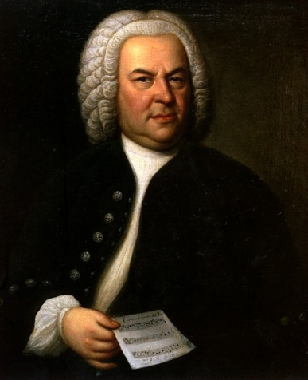
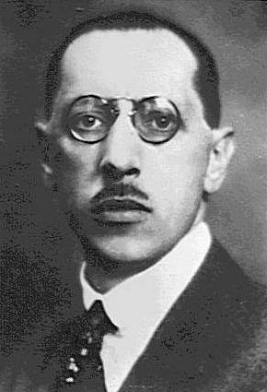
Example: Battle of the Sexes
 |  | II
 |  | B | S
I | B | 3, 1 | 0, 0
 | S | 0, 0 | 1, 3

Slide 201
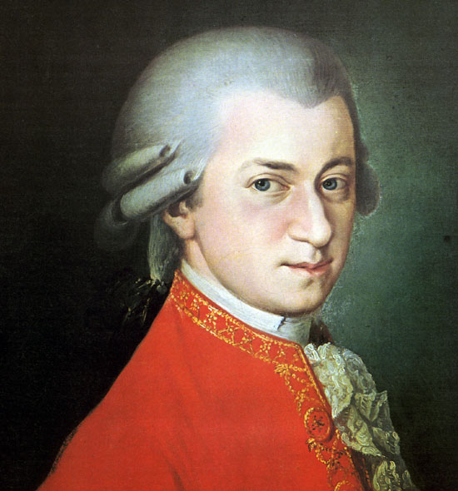
Example: Battle of the Sexes
 |  | II
 |  | B | S | M
I | B | 3, 1 | 0, 0 | 0, 4
 | S | 0, 0 | 1, 3 | 0, 4
 | M | 0, 0 | 0, 0 | 2, 6

Slide 202
Example: A kind of “Battle of the Sexes”
I
not give car
to player II
give car
to player II
 |  | II
 |  | B | S
I | B | 3, 1 | 0, 0
 | S | 0, 0 | 1, 3
 | M | 0, 0 | 0, 0
 |  | II
 |  | B | S | M
I | B | 3, 1 | 0, 0 | 0, 4
 | S | 0, 0 | 1, 3 | 0, 4
 | M | 0, 0 | 0, 0 | 2, 6
S¹_{I} = {any strategy except ones with “M” after not giving the car}
S¹_{II} = {(B, M), (S, M)}
S²_{I} = {(not give, B, M), (give, B, M)}
S²_{II} = {(B, M), (S, M)}
S³_{I} = {not give, B, M), (give, B, M)}
S³_{II} = {(B, M)}
S⁴_{I} = {not give, B, M)}
S⁴_{II} = {(B, M)}
Unique extensive-form rationalizable outcome

Slide 203
Example: A kind of “Battle of the Sexes”
I
not give car
to player II
give car
to player II
 |  | II
 |  | B | S
I | B | 3, 1 | 0, 0
 | S | 0, 0 | 1, 3
 | M | 0, 0 | 0, 0
 |  | II
 |  | B | S | M
I | B | 3, 1 | 0, 0 | 0, 4
 | S | 0, 0 | 1, 3 | 0, 4
 | M | 0, 0 | 0, 0 | 2, 6

Slide 204
Example: A kind of “Battle of the Sexes”
I
not tell player II about
the Mozart concert
tell player II about
the Mozart concert
 |  | II
 |  | B | S
I | B | 3, 1 | 0, 0
 | S | 0, 0 | 1, 3
 | M | 0, 0 | 0, 0
 |  | II
 |  | B | S | M
I | B | 3, 1 | 0, 0 | 0, 4
 | S | 0, 0 | 1, 3 | 0, 4
 | M | 0, 0 | 0, 0 | 2, 6
Two novel features:
Forest of trees, partial order
Information set at a history of a tree may be located in a less expressive tree
 |  | II
 |  | B | S
I | B | 3, 1 | 0, 0
 | S | 0, 0 | 1, 3

Slide 205
Example: A kind of “Battle of the Sexes”
I
not tell player II about
the Mozart concert
tell player II about
the Mozart concert
 |  | II
 |  | B | S
I | B | 3, 1 | 0, 0
 | S | 0, 0 | 1, 3
 | M | 0, 0 | 0, 0
 |  | II
 |  | B | S | M
I | B | 3, 1 | 0, 0 | 0, 4
 | S | 0, 0 | 1, 3 | 0, 4
 | M | 0, 0 | 0, 0 | 2, 6
 |  | II
 |  | B | S
I | B | 3, 1 | 0, 0
 | S | 0, 0 | 1, 3
Notion of strategy

Slide 206
Example: A kind of “Battle of the Sexes”
I
not tell player II about
the Mozart concert
tell player II about
the Mozart concert
 |  | II
 |  | B | S
I | B | 3, 1 | 0, 0
 | S | 0, 0 | 1, 3
 | M | 0, 0 | 0, 0
 |  | II
 |  | B | S | M
I | B | 3, 1 | 0, 0 | 0, 4
 | S | 0, 0 | 1, 3 | 0, 4
 | M | 0, 0 | 0, 0 | 2, 6
 |  | II
 |  | B | S
I | B | 3, 1 | 0, 0
 | S | 0, 0 | 1, 3
Notion of strategy
Player I

Slide 207
Example: A kind of “Battle of the Sexes”
I
not tell player II about
the Mozart concert
tell player II about
the Mozart concert
 |  | II
 |  | B | S
I | B | 3, 1 | 0, 0
 | S | 0, 0 | 1, 3
 | M | 0, 0 | 0, 0
 |  | II
 |  | B | S | M
I | B | 3, 1 | 0, 0 | 0, 4
 | S | 0, 0 | 1, 3 | 0, 4
 | M | 0, 0 | 0, 0 | 2, 6
 |  | II
 |  | B | S
I | B | 3, 1 | 0, 0
 | S | 0, 0 | 1, 3
Notion of strategy
Player I
Player II

Slide 208
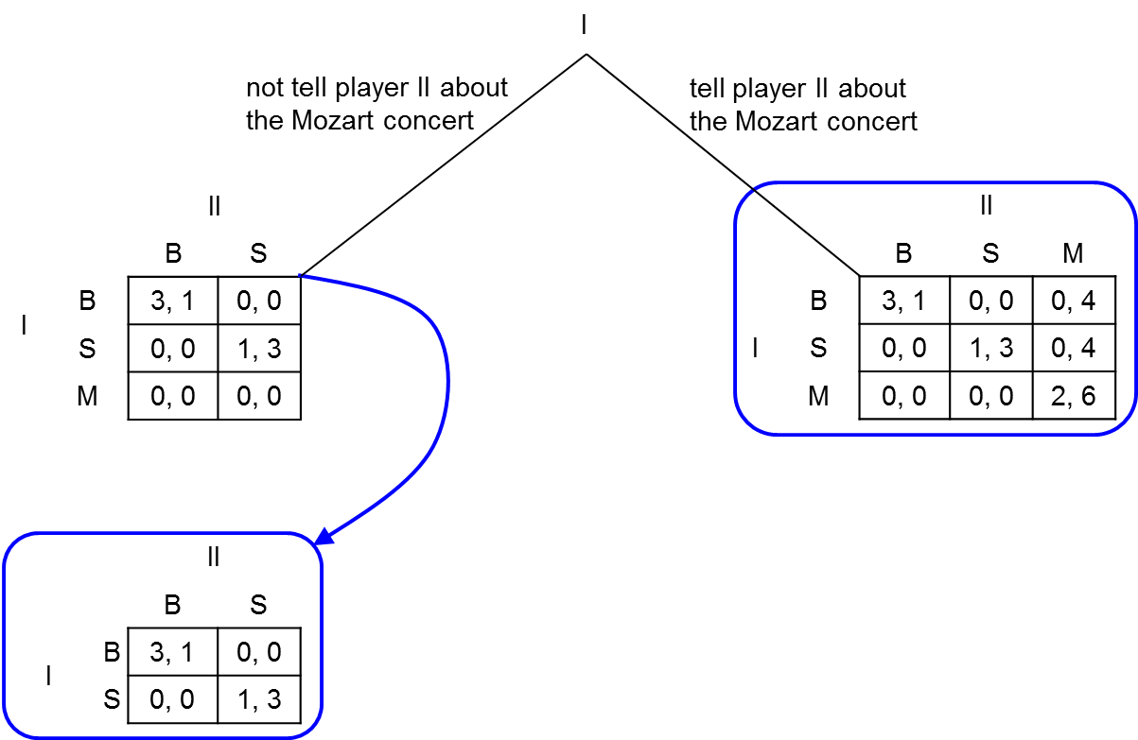
Example: A kind of “Battle of the Sexes”

Slide 209
S¹_{I} = {any strategy except ones with “M” after not tell}
S¹_{II} = {(M, B), (M, S)}
S²_{I} = {don’t tell, B, M, B), (don’t tell, B, M, S),
(tell, B, M, B), (tell, B, M, S)}
S²_{II} = {(M, B), (M, S)}
S³_{I} = {don’t tell, B, M, B), (don’t tell, B, M, S),
(tell, B, M, B), (tell, B, M, S)}
S³_{II} = {(M, B), (M, S)}
Different extensive-form rationalizable outcomes

Slide 210
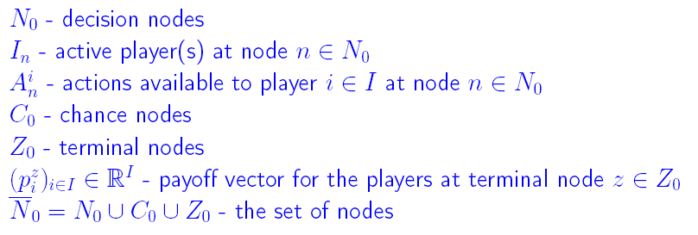
Extensive Form Games with Unawareness

Slide 211
Generalized Game

Slide 212
Partially Ordered Set of Trees

Slide 213
Partially Ordered Set of Trees

Slide 214
Partially Ordered Set of Trees

Slide 215
Partially Ordered Set of Trees

Slide 216

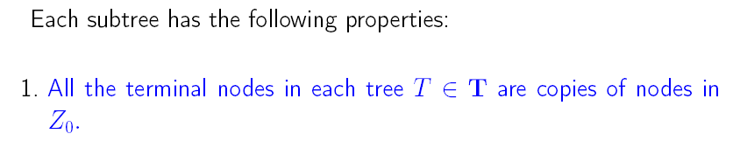
Generalized Game

Slide 217
T
●
●
●
● n
●
●
●
●
●
●
●
●
●
●
T’
n’

Slide 218
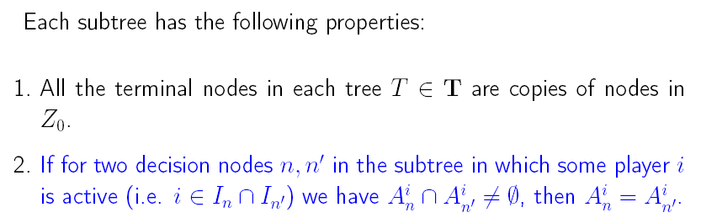
Generalized Game

Slide 219

●
i
● n
i
● n’
a b c a b c
●
●
●
●
●
●

Slide 220
●
●
i
● n
i
● n’
i
● n
i
● n’
a b c a b c
a b c a b c
●
●
●
●
●
●
●
●
●
●
●
●

Slide 221
√
●
●
i
● n
i
● n’
i
● n
i
● n’
a b c d e
a b c a b c
a b c a b
●
●
●
●
●
●
●
●
●
●
●

Slide 222
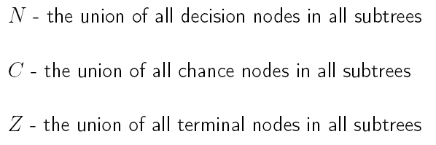


Slide 223

Information sets in a generalized game

Slide 224
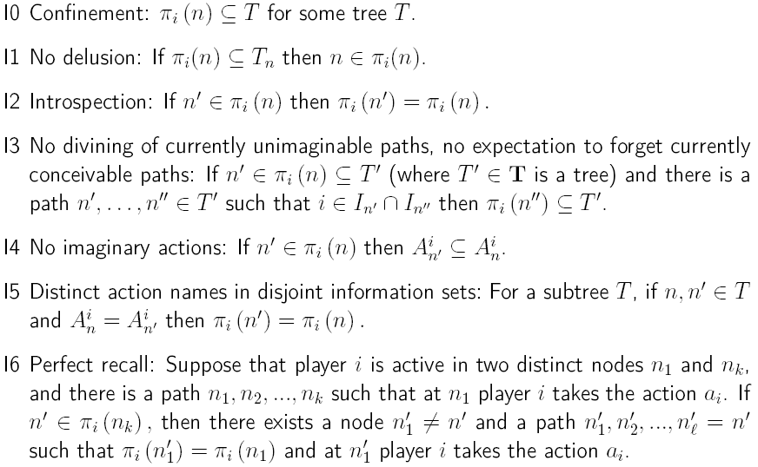

Slide 225
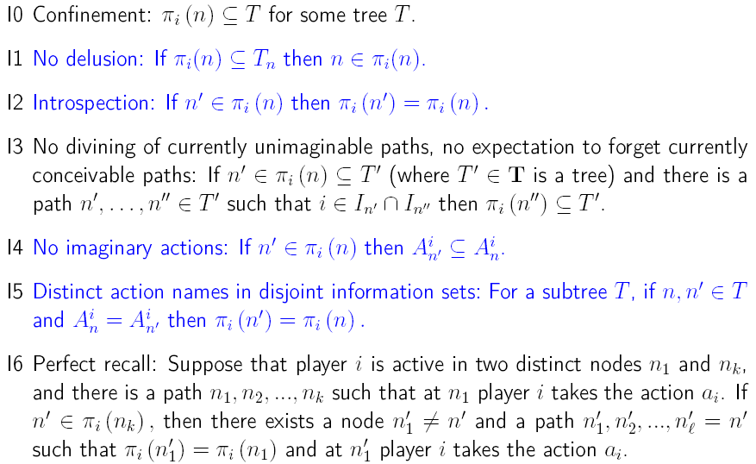
Standard

Slide 226
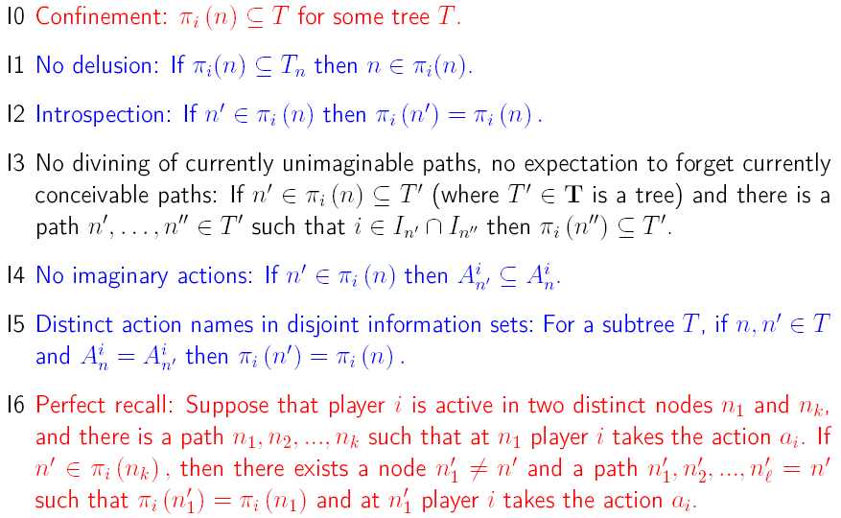
Standard
Generalized

Slide 227
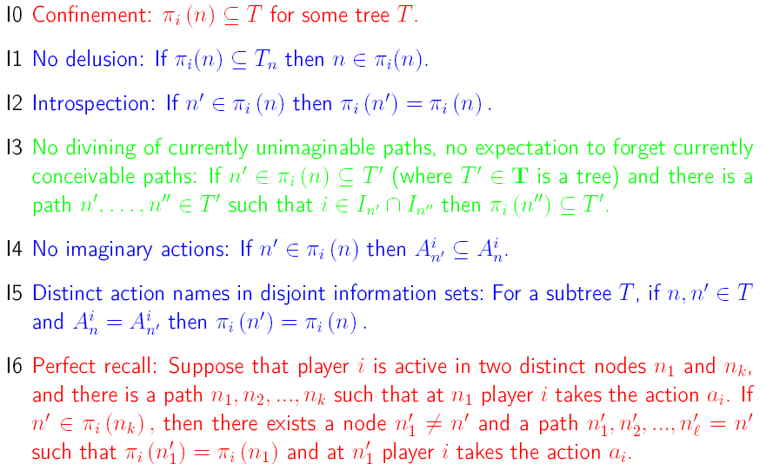
Standard
Generalized
New

Slide 228
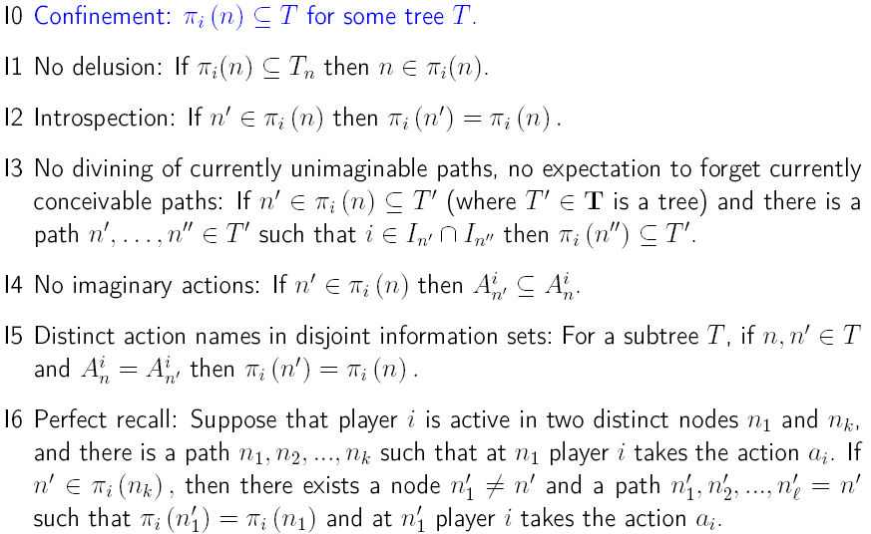

Slide 229
T
●
●
●
● n
●
●
●
●
●
●
●
●
●
●
●
●
T’
n’

Slide 230
T
●
● n
●
●
●
●
●
●
●
T’
●
●
n’
●
●
●
●
●

Slide 231
T
●
● n
●
● n
T
●
●
●
●
●
●
●
●
●
●
●
●
T’
●
Information set across subtrees
●
n’
●
T’
n’
●
●
●
●

Slide 232
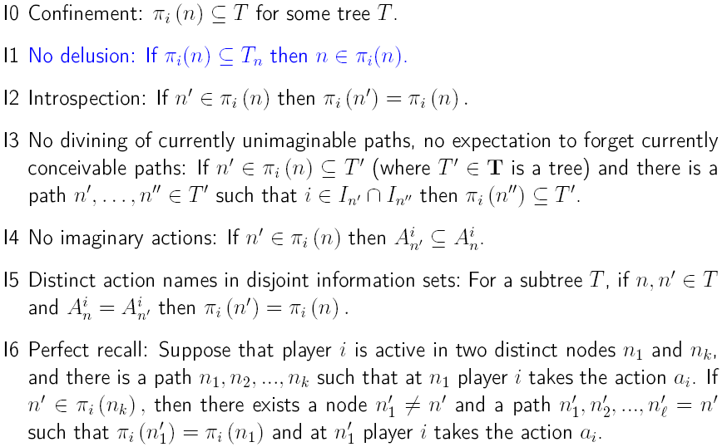

Slide 233
●
●
● n
●
● n
●
●
●
●
●
●
●
●
●

Slide 234
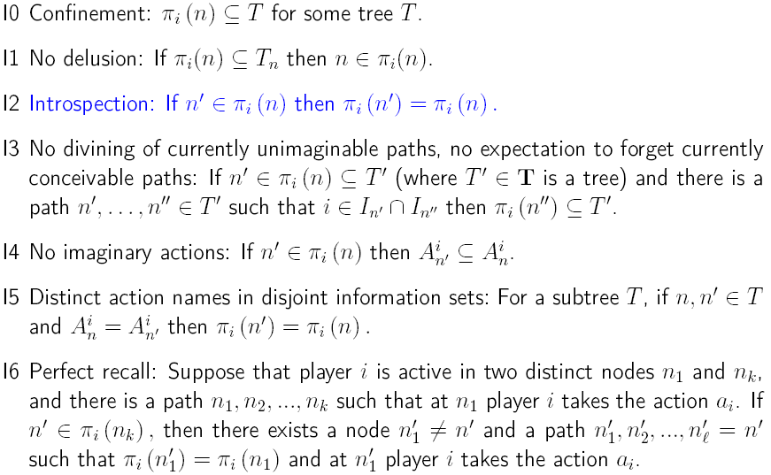

Slide 235
●
● n’
● n
●
●
●
●

Slide 236
●
●
Nested information sets
● n
● n’
● n
● n’
●
●
●
●
●
●
●
●

Slide 237
●
●
● n’
● n
● n’
● n
●
●
●
●
●
●
●
●
●
● n’’
●
●

Slide 238
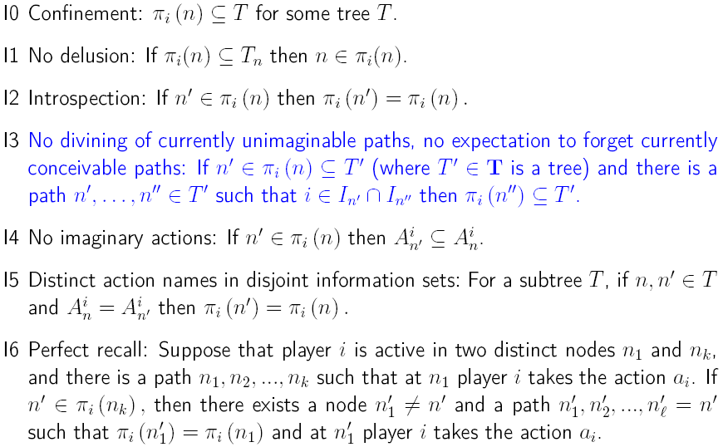

Slide 239

T
i
● n
●
●
●
i
●
●
●
●
●
●
T’
i
● n’
●
●
●
i
●
● n”
●
●
●

Slide 240
T
i
T
i
● n
● n
●
●
●
●
●
i
●
●
i
●
●
●
●
●
●
●
●
●
●
●
T’
i
T’
i
● n’
● n’
●
●
●
●
●
i
●
●
i
●
● n”
● n”
●
●
●
●
●
●

Slide 241
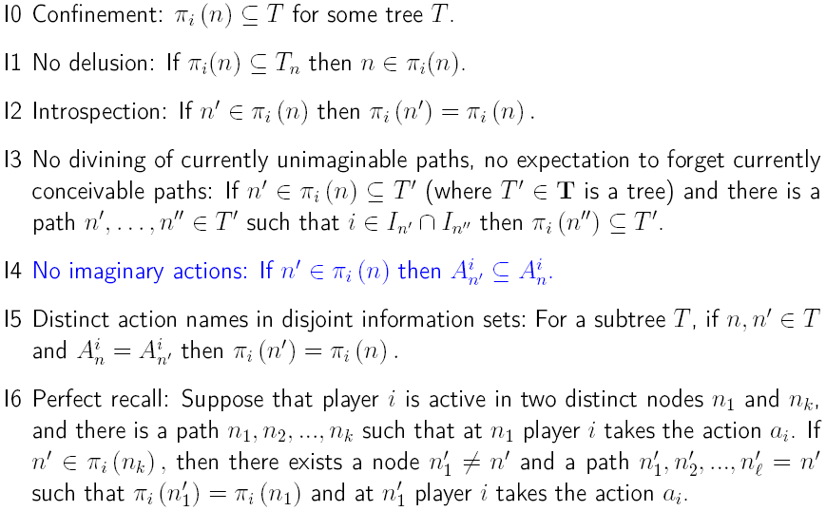

Slide 242
T
● n
a b c
●
●
●
T’
●
n’
a b
●
●

Slide 243
T
T
● n
●
n
a b c
a b
●
●
●
●
●
T’
●
n’
T’
● n’
a b
a b c
●
●
●
●
●

Slide 244
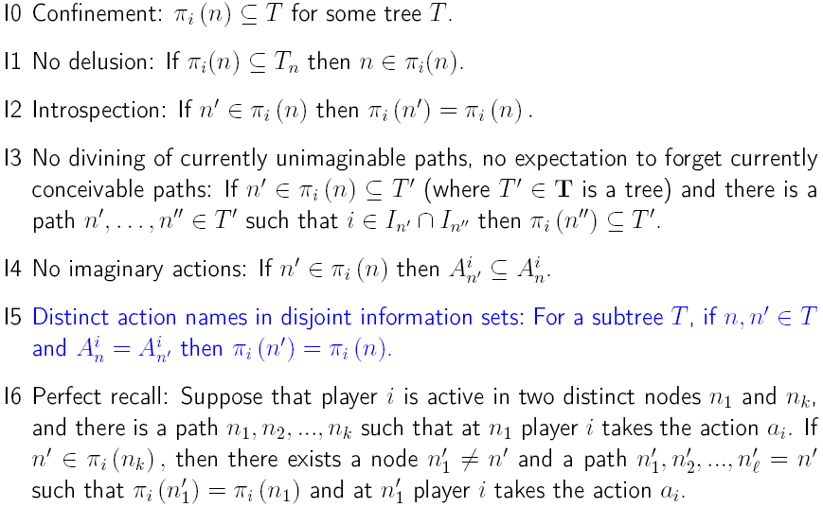

Slide 245
●
● n
● n’
a b a b
●
●
●
●

Slide 246
●
●
● n
● n’
● n
● n’
a b a b
a b a b
●
●
●
●
●
●
●
●

Slide 247
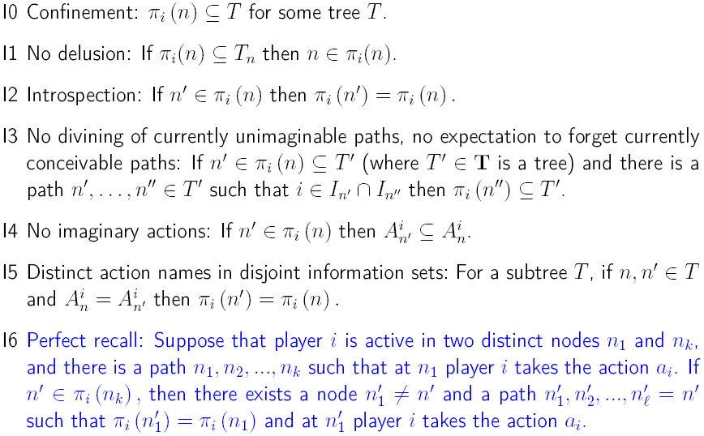

Slide 248
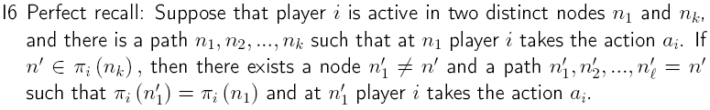
●
● n₁
●
a_{i}
●
●
●
●
●
●
● n_{k}
●
●
●
●n₁’
●
●
a_{i}
●
●
●
●
●
●
● n_{l}’
●
●
●
●
●
●
●
●
●
●
●

Slide 249

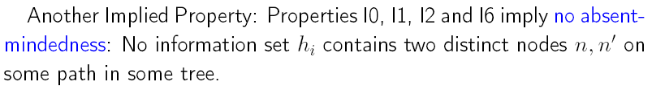
●
●
n’
●
i
●
n’’
●
●

Slide 250
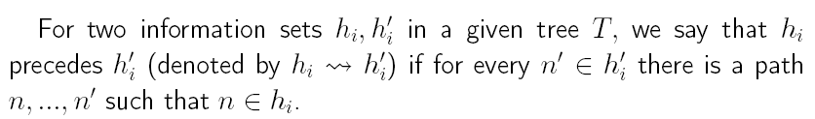
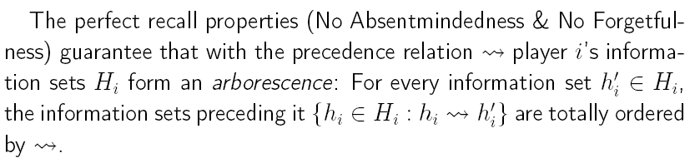
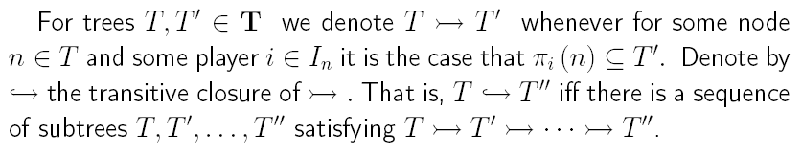

Slide 251
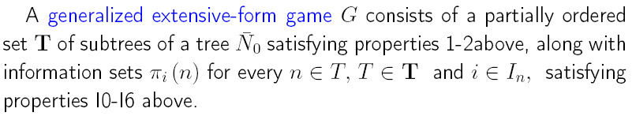
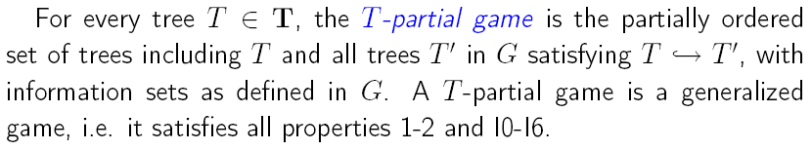
Generalized Extensive-Form Games

Slide 252
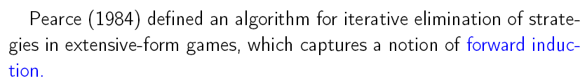
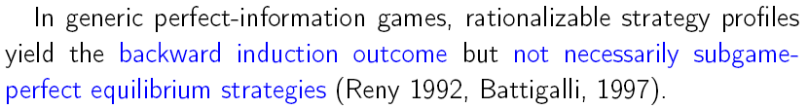

Extensive-form Rationalizability

Slide 253
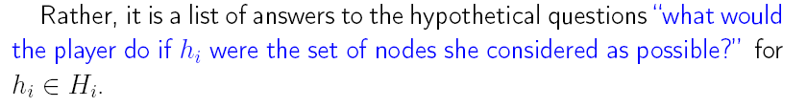
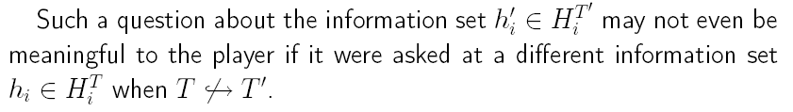
Strategies

Slide 254
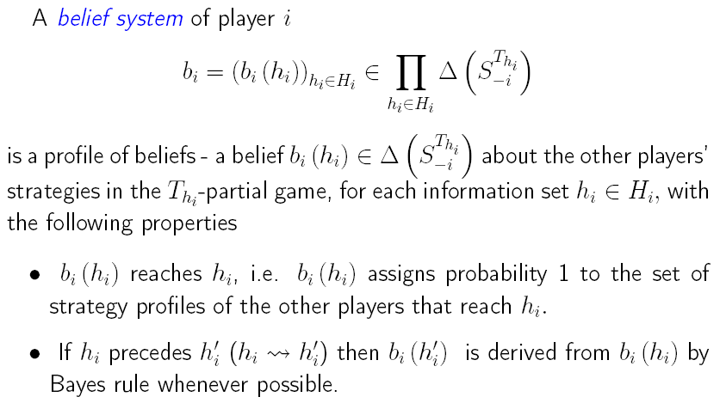
Belief Systems

Slide 255



Slide 256

Generalizing Extensive-form Rationalizability (Pearce 1984, Battigalli 1997) to Dynamic Unawareness

Slide 257

Generalizing Extensive-form Rationalizability (Pearce 1984, Battigalli 1997) to Dynamic Unawareness

Slide 258

Prudent Rationalizability

Slide 259

Prudent Rationalizability
Prudent rationalizability is not a refinement of extensive-form rationalizability in terms of strategies.

Slide 260
Prudence vs. Rationalizability: Divining the opponent's past behavior
I
Prudent rationalizability
Extensive-form rationalizability
a
b c
II
6, 6
d e f d e f
3, 4
4, 3
10, 0
5, 5
6, 6
0, 0

Slide 261
Application to Verifiable Information
1. With Full Awareness: a la Milgrom and Roberts (1986)
One seller, one buyer
One merchandise with quality L or H
For each quality, the seller is better off from selling a larger quantity.
The buyer’s utility is strictly concave in quantity with single peak ¯(¢) and ¯(L) < ¯(H).
Before a sale takes place, the seller can provide a certified signal about the quality: can be imprecise but must be truthful
The buyer’s unique prudent rationalizable strategy is to buy ¯(L) if presented with {L} or {L, H} and ¯(H) if presented with {H}, while the seller’s unique prudent rationalizable strategy is to certify {L, H} when his quality is L and {H} when is quality is H. Full unraveling.

Slide 262
Application to Verifiable Information
2. With Unawareness of a Dimension of Quality
One merchandise with quality q 2 {L, H} £ {0, *}
For instance, available certificates in state (L,0): {L, H} £ {0, *}, {L} £ {0, *}, {L, H} £ {0}, and {L} £ {0}
¯(L,*) < ¯(L,0) < ¯(H,0) < ¯(H,*).
If the buyer is fully aware of both dimensions of quality, we still obtain full unraveling by previous arguments.
Assume now that the buyer is aware only of dimension {L, H} while being unaware of dimension {0, *}. Assume ¯(L) = ¯(L,0) and ¯(H) = ¯(H,0).

Slide 263
c
L⁰ L* H⁰ H*
Seller
Seller
Seller
Seller
{L,H}£{⁰, *}
{L,H}£{⁰, *}
{L,H}£{⁰, *}
{L,H}£{⁰, *}
●
●
●
●
{L,H}£{⁰}
…
{L,H}£{*}
{L,H}£{*}
●
{L,H}£{⁰}
●
{L}£{⁰, *}
{L}£{⁰, *}
{H}£{⁰, *}
…
{H}£{⁰, *}
●
●
{L}£{⁰}
{L}£{*}
…
{H}£{⁰}
{H}£{*}
●
●
●
●
{L, H}
…
{L, H}
{L, H}
…
{L, H}
…
…
…
…
{L}
…
{L}
…
{H}
…
{H}
…
…
…
…
…
c
L
H
Seller
Seller
{L}
{L,H}
{L,H}
{H}
●
●
…
…
…

Slide 264
Application to Verifiable Information
2. With Unawareness of a Dimension of Quality
One merchandise with quality q 2 {L, H} £ {0, *}
For instance, available certificates in state (L,0): {L, H} £ {0, *}, {L} £ {0, *}, {L, H} £ {0}, and {L} £ {0}
¯(L,*) < ¯(L,0) < ¯(H,0) < ¯(H,*).
If the buyer is fully aware of both dimensions of quality, we still obtain full unraveling by previous arguments.
Assume now that the buyer is aware only of dimension {L, H} while being unaware of dimension {0, *}. Assume ¯(L) = ¯(L,0) and ¯(H,0) = ¯(H).
In the verifiable information model in which the buyer is unaware of some dimension of the the good's quality, the seller does not fully reveal the quality in any prudent rationalizable outcome. E.g., (L, *).

Slide 265
Conditional Dominance
Can we capture these solution concepts in “normal-form“ games with unawareness?
How crucial is the “time-structure” for the analysis of strategic interaction under unawareness?

Slide 266
For standard extensive-form games, Shimoji and Watson (JET 1998) show that extensive-form rationalizability is characterized by iterated elimination of conditionally strictly dominated strategies.
Chen and Micali (TE 2012) show order-independence of iterated elimination of conditionally strictly dominated strategies.
How about dynamic games with unawareness?

Slide 267
Example: A kind of “Battle of the Sexes”
I
n
t
 |  | II
 |  | B | S
I | B | 3, 1 | 0, 0
 | S | 0, 0 | 1, 3
 | M | 0, 0 | 0, 0
 |  | II
 |  | B | S | M
I | B | 3, 1 | 0, 0 | 0, 4
 | S | 0, 0 | 1, 3 | 0, 4
 | M | 0, 0 | 0, 0 | 2, 6
 |  | II
 |  | B | S
I | B | 3, 1 | 0, 0
 | S | 0, 0 | 1, 3

Slide 268
Example: A kind of “Battle of the Sexes”
T
I
n
t
 |  | II
 |  | B | S
I | B | 3, 1 | 0, 0
 | S | 0, 1 | 1, 0
 | M | 4, 0 | 2, 3
 |  | II
 |  | B | S | M
I | B | 3, 1 | 0, 0 | 0, 4
 | S | 0, 1 | 1, 0 | 0, 4
 | M | 4, 0 | 2, 3 | 2, 6
 |  | II
 | T’ | B | S
I | B | 3, 1 | 0, 0
 | S | 0, 1 | 1, 0

Slide 269
T
I
n
t
 |  | II
 |  | B | S
I | B | 3, 1 | 0, 0
 | S | 0, 1 | 1, 0
 | M | 4, 0 | 2, 3
 |  | II
 |  | B | S | M
I | B | 3, 1 | 0, 0 | 0, 4
 | S | 0, 1 | 1, 0 | 0, 4
 | M | 4, 0 | 2, 3 | 2, 6
 |  | II
 | T’ | B | S
I | B | 3, 1 | 0, 0
 | S | 0, 1 | 1, 0
What is the associated normal-form game?

Slide 270
 |  | II
 | T | BB | BS | SB | SS | MB | MS
I | nBBB | 3, 1 | 0, 0 | 3, 1 | 0, 0 | 3, 1 | 0, 0
 | nSBB | 0, 1 | 1, 0 | 0, 1 | 1, 0 | 0, 1 | 1, 0
 | nMBB | 4, 0 | 2, 3 | 4, 0 | 2, 3 | 4, 0 | 2, 3
 | nBSB | 3, 1 | 0, 0 | 3, 1 | 0, 0 | 3, 1 | 0, 0
 | nSSB | 0, 1 | 1, 0 | 0, 1 | 1, 0 | 0, 1 | 1, 0
 | nMSB | 4, 0 | 2, 3 | 4, 0 | 2, 3 | 4, 0 | 2, 3
 | nBMB | 3, 1 | 0, 0 | 3, 1 | 0, 0 | 3, 1 | 0, 0
 | nSMB | 0, 1 | 1, 0 | 0, 1 | 1, 0 | 0, 1 | 1, 0
 | nMMB | 4, 0 | 2, 3 | 4, 0 | 2, 3 | 4, 0 | 2, 3
 | nBBS | 3, 1 | 0, 0 | 3, 1 | 0, 0 | 3, 1 | 0, 0
 | nSBS | 0, 1 | 1, 0 | 0, 1 | 1, 0 | 0, 1 | 1, 0
 | nMBS | 4, 0 | 2, 3 | 4, 0 | 2, 3 | 4, 0 | 2, 3
 | nBSS | 3, 1 | 0, 0 | 3, 1 | 0, 0 | 3, 1 | 0, 0
 | nSSS | 0, 1 | 1, 0 | 0, 1 | 1, 0 | 0, 1 | 1, 0
 | nMSS | 4, 0 | 2, 3 | 4, 0 | 2, 3 | 4, 0 | 2, 3
 | nBMS | 3, 1 | 0, 0 | 3, 1 | 0, 0 | 3, 1 | 0, 0
 | nSMS | 0, 1 | 1, 0 | 0, 1 | 1, 0 | 0, 1 | 1, 0
 | nMMS | 4, 0 | 2, 3 | 4, 0 | 2, 3 | 4, 0 | 2, 3
 | tBBB | 3, 1 | 3, 1 | 0, 0 | 0, 0 | 0, 4 | 0, 4
 | tSBB | 3, 1 | 3, 1 | 0, 0 | 0, 0 | 0, 4 | 0, 4
 | tMBB | 3, 1 | 3, 1 | 0, 0 | 0, 0 | 0, 4 | 0, 4
 | tBSB | 0, 1 | 0, 1 | 1, 0 | 1, 0 | 0, 4 | 0, 4
 | tSSB | 0, 1 | 0, 1 | 1, 0 | 1, 0 | 0, 4 | 0, 4
 | tMSB | 0, 1 | 0, 1 | 1, 0 | 1, 0 | 0, 4 | 0, 4
 | tBMB | 4, 0 | 4, 0 | 2, 3 | 2, 3 | 2, 6 | 2, 6
 | tSMB | 4, 0 | 4, 0 | 2, 3 | 2, 3 | 2, 6 | 2, 6
 | tMMB | 4, 0 | 4, 0 | 2, 3 | 2, 3 | 2, 6 | 2, 6
 | tBBS | 3, 1 | 3, 1 | 0, 0 | 0, 0 | 0, 4 | 0, 4
 | tSBS | 3, 1 | 3, 1 | 0, 0 | 0, 0 | 0, 4 | 0, 4
 | tMBS | 3, 1 | 3, 1 | 0, 0 | 0, 0 | 0, 4 | 0, 4
 | tBSS | 0, 1 | 0, 1 | 1, 0 | 1, 0 | 0, 4 | 0, 4
 | tSSS | 0, 1 | 0, 1 | 1, 0 | 1, 0 | 0, 4 | 0, 4
 | tMSS | 0, 1 | 0, 1 | 1, 0 | 1, 0 | 0, 4 | 0, 4
 | tBMS | 4, 0 | 4, 0 | 2, 3 | 2, 3 | 2, 6 | 2, 6
 | tSMS | 4, 0 | 4, 0 | 2, 3 | 2, 3 | 2, 6 | 2, 6
 | tMMS | 4, 0 | 4, 0 | 2, 3 | 2, 3 | 2, 6 | 2, 6
T’ |  | II
 |  | B | S
I | B | 3, 1 | 0, 0
 | S | 0, 1 | 1, 0

Slide 271
 | T | II
 |  | BB | BS | SB | SS | MB | MS
I | nB** | 3, 1 | 0, 0 | 3, 1 | 0, 0 | 3, 1 | 0, 0
 | nS** | 0, 1 | 1, 0 | 0, 1 | 1, 0 | 0, 1 | 1, 0
 | nM** | 4, 0 | 2, 3 | 4, 0 | 2, 3 | 4, 0 | 2, 3
 | t*B* | 3, 1 | 3, 1 | 0, 0 | 0, 0 | 0, 4 | 0, 4
 | t*S* | 0, 1 | 0, 1 | 1, 0 | 1, 0 | 0, 4 | 0, 4
 | t*M* | 4, 0 | 4, 0 | 2, 3 | 2, 3 | 2, 6 | 2, 6
1.
1.
2.
1.
1.
 |  | II
 | T’ | B | S
I | B | 3, 1 | 0, 0
 | S | 0, 1 | 1, 0
2.
1.
Iterated conditional dominance coincides with extensive-form rationalizability.

Slide 272
Iterated conditional dominance requires normal-form information sets and thus structure from the extensive-form. Can we dispense with any extensive-form structure entirely and obtain forward-induction outcomes in the associated normal-form game?
=> Iterated admissibility?

Slide 273
Iterated admissibility:
 | T | II
 |  | BB | BS | SB | SS | MB | MS
I | nB** | 3, 1 | 0, 0 | 3, 1 | 0, 0 | 3, 1 | 0, 0
 | nS** | 0, 1 | 1, 0 | 0, 1 | 1, 0 | 0, 1 | 1, 0
 | nM** | 4, 0 | 2, 3 | 4, 0 | 2, 3 | 4, 0 | 2, 3
 | t*B* | 3, 1 | 3, 1 | 0, 0 | 0, 0 | 0, 4 | 0, 4
 | t*S* | 0, 1 | 0, 1 | 1, 0 | 1, 0 | 0, 4 | 0, 4
 | t*M* | 4, 0 | 4, 0 | 2, 3 | 2, 3 | 2, 6 | 2, 6
1.
1.
A naïve approach would delete
MB in the second step, which is
the only extensive-form
rationalizable strategy (i.e., the only strategy capturing forward induction)!
1.
 |  | II
 | T’ | B | S
I | B | 3, 1 | 0, 0
 | S | 0, 1 | 1, 0
1.

Slide 274
How about iterated admissibility?
 | T | II
 |  | BB | BS | SB | SS | MB | MS
I | nB** | 3, 1 | 0, 0 | 3, 1 | 0, 0 | 3, 1 | 0, 0
 | nS** | 0, 1 | 1, 0 | 0, 1 | 1, 0 | 0, 1 | 1, 0
 | nM** | 4, 0 | 2, 3 | 4, 0 | 2, 3 | 4, 0 | 2, 3
 | t*B* | 3, 1 | 3, 1 | 0, 0 | 0, 0 | 0, 4 | 0, 4
 | t*S* | 0, 1 | 0, 1 | 1, 0 | 1, 0 | 0, 4 | 0, 4
 | t*M* | 4, 0 | 4, 0 | 2, 3 | 2, 3 | 2, 6 | 2, 6
1.
1.
A naïve approach would delete
MB in the second step, which is
the only extensive-form
rationalizable strategy (i.e., the only strategy capturing forward induction)!
1.
 |  | II
 | T’ | B | S
I | B | 3, 1 | 0, 0
 | S | 0, 1 | 1, 0
1.
Iterated admissibility must rely on information sets (i.e., extensive-form structures).

Slide 275
How about iterated admissibility?
 | T | II
 |  | BB | BS | SB | SS | MB | MS
I | nB** | 3, 1 | 0, 0 | 3, 1 | 0, 0 | 3, 1 | 0, 0
 | nS** | 0, 1 | 1, 0 | 0, 1 | 1, 0 | 0, 1 | 1, 0
 | nM** | 4, 0 | 2, 3 | 4, 0 | 2, 3 | 4, 0 | 2, 3
 | t*B* | 3, 1 | 3, 1 | 0, 0 | 0, 0 | 0, 4 | 0, 4
 | t*S* | 0, 1 | 0, 1 | 1, 0 | 1, 0 | 0, 4 | 0, 4
 | t*M* | 4, 0 | 4, 0 | 2, 3 | 2, 3 | 2, 6 | 2, 6
1.
1.
2.
1.
A naïve approach would delete
MB in the second step, which is
the only extensive-form
rationalizable strategy (i.e., the only strategy capturing forward induction)!
1.
 |  | II
 | T’ | B | S
I | B | 3, 1 | 0, 0
 | S | 0, 1 | 1, 0
2.
1.
Iterated admissibility must rely on information sets (i.e., extensive-form structures).

Slide 276
We defined the normal form associated to dynamic games with unawareness.
We characterize extensive-form rationalizability by iterative conditional strict dominance and prudent rationalizability by iterative conditional weak dominance.
We show that iterative admissibility in the associated normal form must depend on information sets.
We show that iterative conditional weak dominance coincides with iterated admissibility in dynamic games with unawareness.

Slide 277
Other approaches to extensive-form games with unawareness

Slide 278
An Example: Unforeseen Roadwork (Feinberg 2012)
Alice (baker), Bob (coffee-shop owner), Carol (Alice’s worker)
Alice has to deliver pastries to Bob on Monday or with penalties on Tuesdays or Wednesdays unless unforeseen contingencies occur
Bob notices unforeseen roadwork on Monday morning that is likely to delay delivery; Bob thinks that Alice is unaware of roadwork
Bob can decide to call Alice and renegotiate later delivery
Carol notices upcoming roadwork on Sunday and emails Alice; Bob is unaware of Carol

Slide 279
¡; = ¡Road Work noticed by Carol, e-mail, Not Call
= ¡Road Work Notice by Carol, e-mail, Call Alice
= …
Feinberg (2012)
Nature
Road Work noticed by Carol
Road Work
Carol
No Road Work
Not e-mail
e-mail
Bob
Bob
Not Call
Call Alice
Not Call
Call Alice
Not Call
Call Alice
Alice
Alice
Alice
Alice
Alice
Alice
M
T
W
M
T
W
M
T
W
M
T
W
M
T
W
M
T
W
M
T
W
Nature
¡ _{Road Work} = ¡ Road Work noticed by Carol, No e-mail,
= ¡ Road Work noticed by Carol, E-mail = ¡ _{Road Work, Call Alice}
= ¡ Road Work noticed by Carol, No e-mail, Call Alice
= …
Road Work
No Road Work
Bob
Not Call
Call Alice
Alice
Alice
M
T
W
M
T
W
M
T
W
Alice
M
T
W
¡ _{No Road Work}
= ¡ _{Road Work, Not Call}
= ¡ Road Work noticed by Carol, No e-mail, Not Call
= …

Slide 280
Halpern and Rego (MSS 2014)
Nature
¡
Road Work noticed by Carol
Road Work
Carol
No Road Work
Not e-mail
e-mail
Bob
Bob
Not Call
Call Alice
Not Call
Call Alice
Not Call
Call Alice
Alice
Alice
Alice
Alice
Alice
Alice
M
T
W
M
T
W
M
T
W
M
T
W
M
T
W
M
T
W
M
T
W
Nature
¡¹
Road Work
No Road Work
Bob
Not Call
Call Alice
Alice
Alice
M
T
W
M
T
W
M
T
W
Alice
¡²
M
T
W

Slide 281
Grant and Quiggin (ET 2013)
Nature
¡
Road Work noticed by Carol
Road Work
Carol
No Road Work
Not e-mail
e-mail
Bob
Bob
Not Call
Call Alice
Not Call
Call Alice
Not Call
Call Alice
Alice
Alice
Alice
Alice
Alice
Alice
M
T
W
M
T
W
M
T
W
M
T
W
M
T
W
M
T
W
M
T
W
Nature
¡¹
Road Work
No Road Work
Bob
Not Call
Call Alice
Alice
Alice
M
T
W
M
T
W
M
T
W
Alice
¡²
M
T
W

Slide 282
Heifetz, Meier, Schipper (GEB 2013)
Nature
¡
Road Work noticed by Carol
Road Work
Carol
No Road Work
Not e-mail
e-mail
Bob
Bob
Bob
Not Call
Call Alice
Not Call
Call Alice
Not Call
Call Alice
Alice
Alice
Alice
Alice
Alice
Alice
Alice
M
T
W
M
T
W
M
T
W
M
T
W
M
T
W
M
T
W
M
T
W
Nature
¡¹
Road Work
No Road Work
Bob
Not Call
Call Alice
Alice
Alice
M
T
W
M
T
W
M
T
W
Alice
¡²
M
T
W

Slide 283
In a Nutshell:
Similarity: Every approach uses a forest of game trees.
Main differences: How is dynamic awareness represented in the forest of game trees:
Feinberg: infinite sequences of views
Halpern-Rego: awareness correspondence
Grant-Quggin: perception correspondence
Heifetz, Meier, and Schipper: information sets
Solution concepts:
Feinberg, Halpern-Rego, Grant-Quiggin: Sequential equilibrium
Heifetz, Meier, and Schipper: Extensive-form rationalizability

Slide 284
Self-confirming games

Slide 285
Self-confirming games
Questions:
How do we arrive at our perceptions of strategic contexts?
How to model the process of discovering novel features of “repeated” strategic contexts?
Is there something like a “steady-state” of perceptions and if there is do they necessarily involve a common perception among players?
Is there a notion of equilibrium that makes sense in dynamic strategic interaction under unawareness?

Slide 286
Equilibrium under unawareness?
Problems:
Although mathematical definitions of standard equilibrium concepts can be extended to games with unawareness (Halpern and Rego, 2014, Rego and Halpern, 2012, Feinberg, 2012, Li 2008, Grant and Quiggin, 2013, Ozbay, 2007, Meier and Schipper, 2013), they cannot be interpreted as steady-states of behavior.
Players could not learn equilibrium through repeated play because they become aware of novel features. The perception of the game may “change” between “repetitions” and even along the supposed equilibrium path of a given game with unawareness.
How to reconcile equilibrium notions and non-equilibrium solutions (i.e., extensive-form rationalizability) in games with unawareness?

Slide 287
Main ideas
Formal model of rationalizable discoveries in games with unawareness
Explain endogenously how players perceive strategic contexts.
Existence of equilibrium of perceptions and behavior: Show that for every game with unawareness there exists a discovered version that can be viewed as a steady-state of player’s perceptions and possess an equilibrium that can be interpreted as a steady-state of behavior.

Slide 288
Examples

Slide 289
1
l₁
r₁
2
l₂
r₂
1, 7
m₂
10,5
0,10
5, 6
TexPoint fonts used in EMF.
Read the TexPoint manual before you delete this box.: AA

Slide 290
1
1
l₁
r₁
l₁
r₁
2
2
1, 7
l₂
r₂
1, 7
l₂
r₂
m₂
10,5
0,10
5, 6
10,5
5, 6
TexPoint fonts used in EMF.
Read the TexPoint manual before you delete this box.: AA

Slide 291
1
l₁
r₁
2
l₂
r₂
1, 7
m₂
10,5
0,10
5, 6
1
l₁
r₁
2
l₂
r₂
1, 7
10,5
5, 6
TexPoint fonts used in EMF.
Read the TexPoint manual before you delete this box.: AA

Slide 292
1
l₁
r₁
2
l₂
r₂
1, 7
m₂
10,5
0,10
5, 6
1
l₁
r₁
2
l₂
r₂
1, 7
10,5
5, 6
TexPoint fonts used in EMF.
Read the TexPoint manual before you delete this box.: AA

Slide 293
1
l₁
r₁
2
l₂
r₂
1, 7
m₂
10,5
0,10
5, 6
1
l₁
r₁
2
l₂
r₂
1, 7
10,5
5, 6
TexPoint fonts used in EMF.
Read the TexPoint manual before you delete this box.: AA

Slide 294
1
l₁
r₁
2
l₂
r₂
1, 7
m₂
10,5
0,10
5, 6
1
l₁
r₁
2
l₂
r₂
1, 7
10,5
5, 6
TexPoint fonts used in EMF.
Read the TexPoint manual before you delete this box.: AA

Slide 295
1
l₁
r₁
2
l₂
r₂
1, 7
m₂
10,5
0,10
5, 6
1
l₁
r₁
2
l₂
r₂
1, 7
10,5
5, 6
TexPoint fonts used in EMF.
Read the TexPoint manual before you delete this box.: AA

Slide 296
1
l₁
r₁
2
l₂
r₂
1, 7
m₂
10,5
0,10
5, 6
1
l₁
r₁
2
l₂
r₂
1, 7
10,5
5, 6
TexPoint fonts used in EMF.
Read the TexPoint manual before you delete this box.: AA

Slide 297
1
l₁
r₁
2
l₂
r₂
1, 7
m₂
10,5
0,10
5, 6
1
l₁
r₁
2
l₂
r₂
1, 7
10,5
5, 6
TexPoint fonts used in EMF.
Read the TexPoint manual before you delete this box.: AA

Slide 298
1
l₁
r₁
2
???
l₂
r₂
1, 7
m₂
10,5
0,10
5, 6
1
l₁
r₁
2
l₂
r₂
1, 7
10,5
5, 6
TexPoint fonts used in EMF.
Read the TexPoint manual before you delete this box.: AA

Slide 299
1
l₁
r₁
2
l₂
r₂
1, 7
m₂
10,5
0,10
5, 6
1
l₁
r₁
2
l₂
r₂
1, 7
10,5
5, 6
TexPoint fonts used in EMF.
Read the TexPoint manual before you delete this box.: AA

Slide 300
Does discovery always lead to common awareness?
Rationalizable discoveries versus non-rationalizable discoveries: Does rational play select among discoveries and thus representations of the strategic context?

Slide 301
1
*
-1, 8
l₁
r₁
2
l₂
r₂
1, 7
m₂
10,5
0,10
5, 6
1
1
*
-1,8
l₁
r₁
l₁
r₁
2
2
l₂
r₂
1, 7
l₂
r₂
1, 7
m₂
10, 5
0,10
5, 6
10,5
5, 6
1
l₁
r₁
2
l₂
r₂
1, 7
10,5
5, 6

Slide 302
1
*
-1, 8
l₁
r₁
2
l₂
r₂
1, 7
m₂
10,5
0,10
5, 6
1
1
*
-1,8
l₁
r₁
l₁
r₁
2
2
l₂
r₂
1, 7
l₂
r₂
1, 7
m₂
10, 5
0,10
5, 6
10,5
5, 6
1
l₁
r₁
2
l₂
r₂
1, 7
10,5
5, 6

Slide 303
1
*
-1, 8
l₁
r₁
2
l₂
r₂
1, 7
m₂
10,5
0,10
5, 6
1
1
*
-1,8
l₁
r₁
l₁
r₁
2
2
l₂
r₂
1, 7
l₂
r₂
1, 7
m₂
10, 5
0,10
5, 6
10,5
5, 6
1
l₁
r₁
2
l₂
r₂
1, 7
10,5
5, 6

Slide 304
1
*
-1,8
l₁
r₁
2
l₂
r₂
1, 7
m₂
10,5
0,10
5, 6
1
1
*
-1,8
l₁
r₁
l₁
r₁
2
2
l₂
r₂
1, 7
l₂
r₂
1, 7
m₂
10, 5
0,10
5, 6
10,5
5, 6
1
l₁
r₁
2
l₂
r₂
1, 7
10,5
5, 6

Slide 305
1
*
-1,8
l₁
r₁
2
l₂
r₂
1, 7
m₂
10,5
0,10
5, 6
1
1
*
-1,8
l₁
r₁
l₁
r₁
2
2
l₂
r₂
1, 7
l₂
r₂
1, 7
m₂
10, 5
0,10
5, 6
10,5
5, 6
1
l₁
r₁
2
l₂
r₂
1, 7
10,5
5, 6

Slide 306
1
*
-1, 8
l₁
r₁
2
l₂
r₂
1, 7
m₂
10,5
0,10
5, 6
1
1
*
-1,8
l₁
r₁
l₁
r₁
2
2
l₂
r₂
1, 7
l₂
r₂
1, 7
m₂
10, 5
0,10
5, 6
10,5
5, 6
1
l₁
r₁
2
l₂
r₂
1, 7
10,5
5, 6

Slide 307
1
*
-1, 8
l₁
r₁
2
l₂
r₂
1, 7
m₂
10, 5
0,10
5, 6
1
1
*
-1,8
l₁
r₁
l₁
r₁
2
2
l₂
r₂
1, 7
l₂
r₂
1, 7
m₂
10, 5
0,10
5, 6
10,5
5, 6
1
l₁
r₁
2
l₂
r₂
1, 7
10,5
5, 6

Slide 308
1
*
-1, 8
l₁
r₁
2
l₂
r₂
1, 7
m₂
10, 5
0,10
5, 6
1
1
*
-1,8
l₁
r₁
l₁
r₁
2
2
l₂
r₂
1, 7
l₂
r₂
1, 7
m₂
10, 5
0,10
5, 6
10,5
5, 6
1
l₁
r₁
2
l₂
r₂
1, 7
10,5
5, 6

Slide 309
1
*
-1, 8
l₁
r₁
2
l₂
r₂
1, 7
m₂
10,5
0,10
5, 6
1
1
*
-1, 8
l₁
r₁
l₁
r₁
2
2
l₂
r₂
1, 7
l₂
r₂
1, 7
m₂
10,5
0,10
5, 6
10,5
5, 6
1
l₁
r₁
2
l₂
r₂
1, 7
10,5
5, 6

Slide 310
1
*
-1, 8
l₁
r₁
2
l₂
r₂
1, 7
m₂
10,5
0,10
5, 6
1
1
*
-1, 8
l₁
r₁
l₁
r₁
2
2
l₂
r₂
1, 7
l₂
r₂
1, 7
m₂
10,5
0,10
5, 6
10,5
5, 6
1
l₁
r₁
2
l₂
r₂
1, 7
10,5
5, 6

Slide 311
Consider extensive-form games with unawarenes a la Heifetz, Meier, Schipper (2013) with the stronger properties of unawareness.
Require additionally that the set of trees is a lattice.
Devise information sets also at terminal nodes.

Slide 312
Self-confirming equilibrium
Profile of behavioral strategies satisfying: For each player
(0) awareness is self-confirming (i.e. constant) along the path(s)
is rational along the path(s)
beliefs are self-confirming (constant and correct) along the path(s)

Slide 313
Mutual knowledge of no changes of awareness?
Lemma: No change of awareness for each player implies “mutual knowledge” of no change of awareness.
Proof: Follows from complete lattice of trees and conditions on info. sets.

Slide 314
Existence of self-confirming equilibrium
exists in standard games
often fails in games with unawareness (because of changes of awareness implied by rational play)
A game is a self-confirming game if it possesses a self-confirming equilibrium.
Remark: Every game with common constant awareness is a self-confirming game. Converse is false.

Slide 315
Discovered version
Given an extensive-form game with unawareness and a strategy profile, the discovered version is defined by
the same set of players, same lattice of trees, the same player function, same payoffs
“updated” information sets:

Slide 316
T⁵
:
:
T⁴
:
:
T³
:
:
T²
:
T¹
:

Slide 317
T⁵
:
:
T⁴
:
:
T³
:
:
T²
:
T¹
:

Slide 318
T⁵
:
:
T⁵
:
:
T⁴
:
:
T⁴
:
:
T³
:
:
T³
:
:
T²
:
T²
:
T²
:
T¹
:

Slide 319
Discovered version
Discovered versions are well-defined:
Lemma: For any extensive-form game with unawareness and strategy profile, the discovered version is an extensive-form game with unawareness.
Lemma: Given an extensive-form game with unawareness, any two strategy profiles that generate the same path have identical discovered versions.

Slide 320
Discovery process
Finite state machine:
Set of states: set of extensive-form games with unawareness (with identical upmost tree)
Initial state/game
Output function assigns strategy profile to each game
Transition function assigns the discovered version to each game and strategy profile
Final states/games (absorbing)

Slide 321
Discovery process
Proposition: For every discovery process, the final state exists and is unique.
Remark: Final states may not have common constant awareness.
Proposition: For every extensive-form game with unawareness, there exists a discovery process that leads to a self-confirming game.
Remark: Typically extensive-form games with unawareness have several self-confirming versions.

Slide 322
Extensive-form rationalizability
Inductive definition
Level 0
All belief systems
Any strategy for which there exists a belief system such that the strategy is optimal at every non-terminal info. set.
Level k
All belief systems concentrated on k-1 level rationalizable strategies of opponents if possible.
Any strategy for which there exists a level-k belief system such that the strategy is optimal at every non-terminal info. set.
Extensive-form rationalizable strategies: intersection of every level-k rationalizable strategy sets.

Slide 323
Rationalizable discoveries
A discovery process is rationalizable if the output function assigns to each game an extensive-form rationalizable strategy.
Proposition: For every extensive-form game with unawareness, there exists a rationalizable discovery process whose final state is a self-confirming version. This refines the set of self-confirming versions.

Slide 324
Rationalizable self-confirming equilibrium
A self-confirming equilibrium is rationalizable if non-rationalizable paths of play have zero probability. (???)
Conjecture: For every extensive-form game with unawareness, there exists a rationalizable discovery process whose final state is a game with a rationalizable self-confirming equilibrium.

Slide 325
Applications of unawareness
Dynamic games: Halpern and Rego (MSS 2014), Rego and Halpern (IJGT 2012), Heifetz, Meier, and Schipper (GEB 2013), Feinberg (2004, 2005, 2012), Grant and Quiggin (ET 2013), Li (2006), Ozbay (2008), Nielsen and Sebald (2013)
Bayesian games with unawareness: Meier and Schipper (ET 2014), Sadzik (2006)
Value of information, value of awareness: Galanis (2013), Quiggin (2013)
Disclosure of information: Heifetz, Meier, and Schipper (2012), Li, Peitz, and Zhao (MSS 2014), Schipper and Woo (2015)
Contract theory: Auster (GEB 2013), Filiz-Ozbay (GEB 2012), Grant, Kline, and Quiggin (JEBO 2012), Lee (2008), Zhao and van Thadden (RES 2013)
Decision theory: Karni and Viero (AER 2013), Schipper (IJGT 2013), Li (2006)
Electoral Campaigning: Schipper and Woo (2015)
General equilibrium: Exchange economies: Modica, Rustichini, and Thallon (ET 1998), Production economies: Kawamura (JET 2005)
Finance: Siddiqi (2014)
… (need more)

Slide 326
I am looking forward to receiving your paper on unawareness.

